Slide 1

KauN banega crorepati
Advance Programming Lab Project
Created By :
Priyansh Agrawal (2014UCP1388) Shubham Singhal (2014UCP1420)

Slide 2
Objective
To make a KBC game, with no repetition of questions and with the consideration of all user interests.
Database is used for storing the questions along with one correct and three wrong answers and the relative details of users.
Tools/Languages used –
C++ for Logic Implementation
OpenGL for graphical user interface.

Slide 3
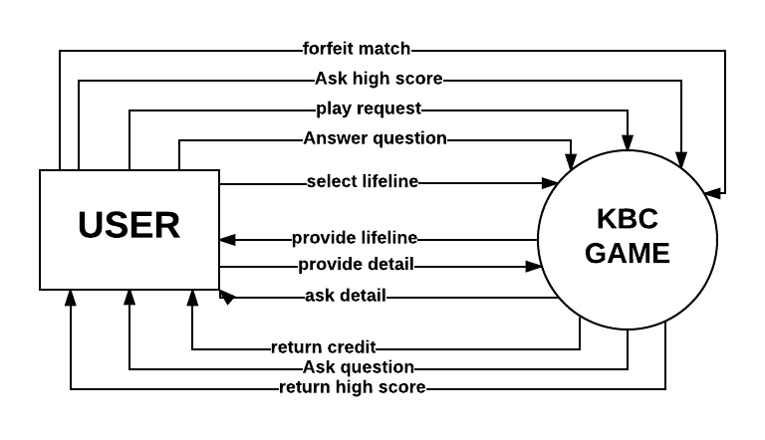
DFD Level 0

Slide 4
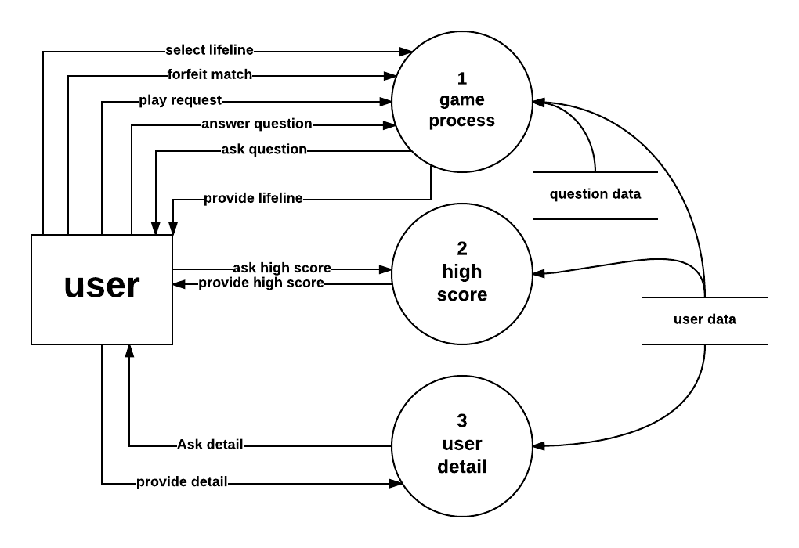
DFD Level 1

Slide 5
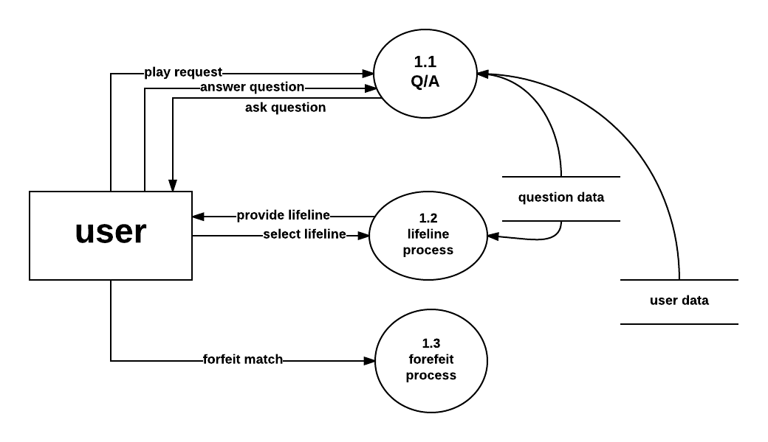
DFD Level 2

Slide 6
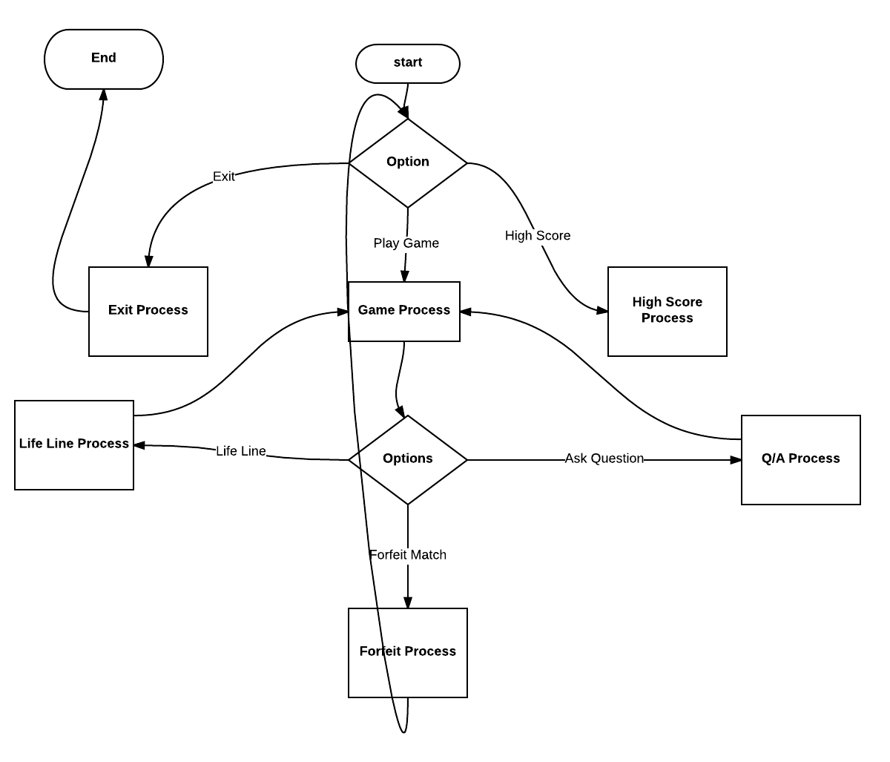
Control Flow Graph

Slide 7
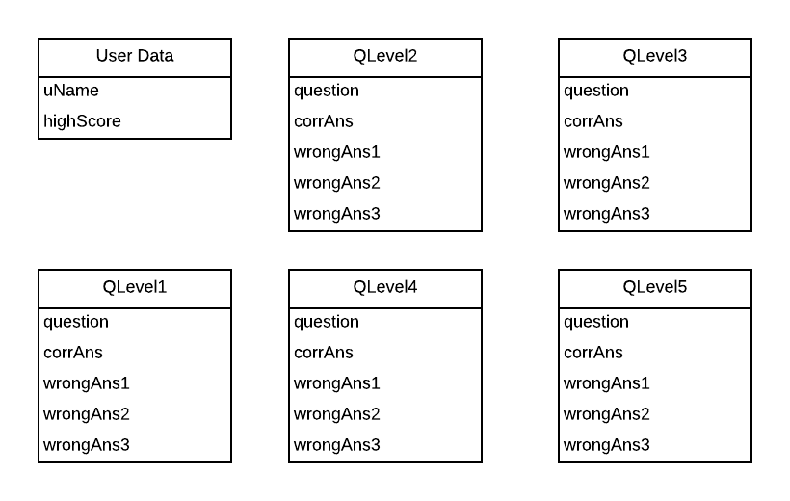
ER Diagram

Slide 8


